Slide 1
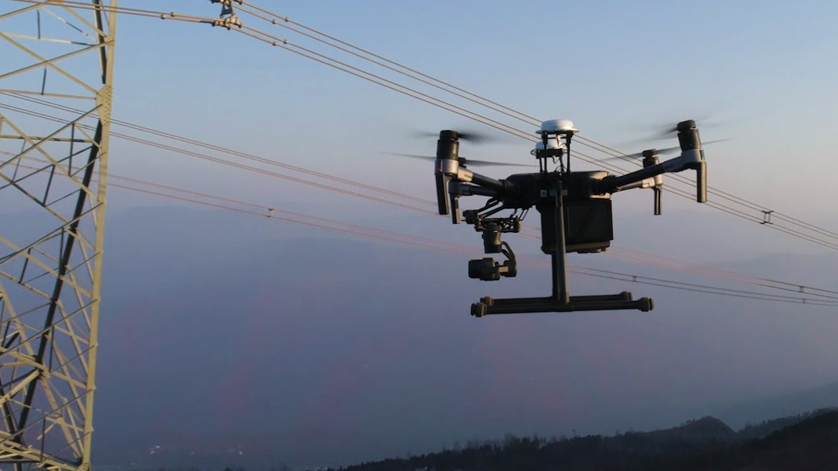
Autonomous Drone for Power Line Inspections
Talha Bin Amir, Adam Woughter, Joseph Ellis, Brian Vu

Slide 2
Overview
Autonomous drones that can inspect power lines are needed for multiple reasons:
Power line inspections are expensive
They are also dangerous for the powerlineman
The methods used currently are slow and take a lot of time
Having autonomous drones that can leave a substation, go inspect power lines and return to the substation can make power line inspections easier, safer, cheaper and faster.

Slide 3
Driving Requirements
Autonomous flight
Drone shall take off, fly a predetermined path and return home after mission
Obstacle avoidance
Drone shall avoid obstacles that might come in its path
Drone shall avoid the power lines while inspecting
Safe return to home
Drone shall return to home once mission is complete, battery level has reached 60% or weather conditions are unsafe for flight
Battery life
Drone shall have maximum flight time possible
Imaging and inspection
Drone shall use visual and thermal imaging to inspect the power lines

Slide 4
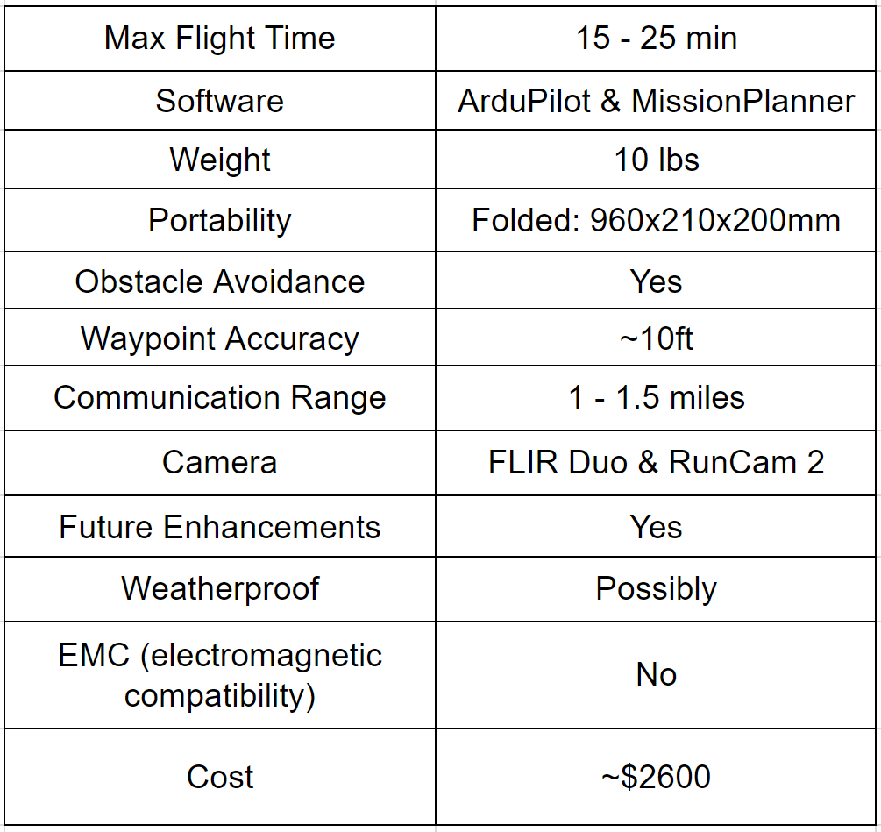
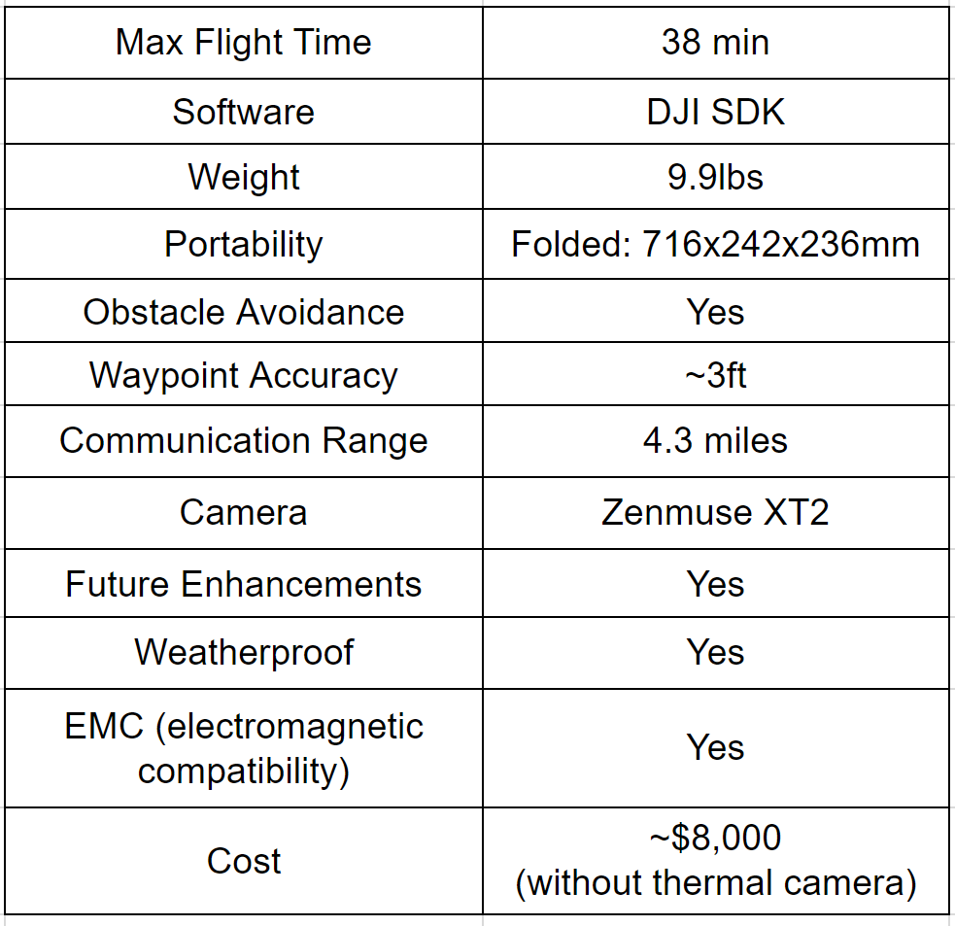
Potential Designs
Hexacopter Build:
DJI:

Slide 5
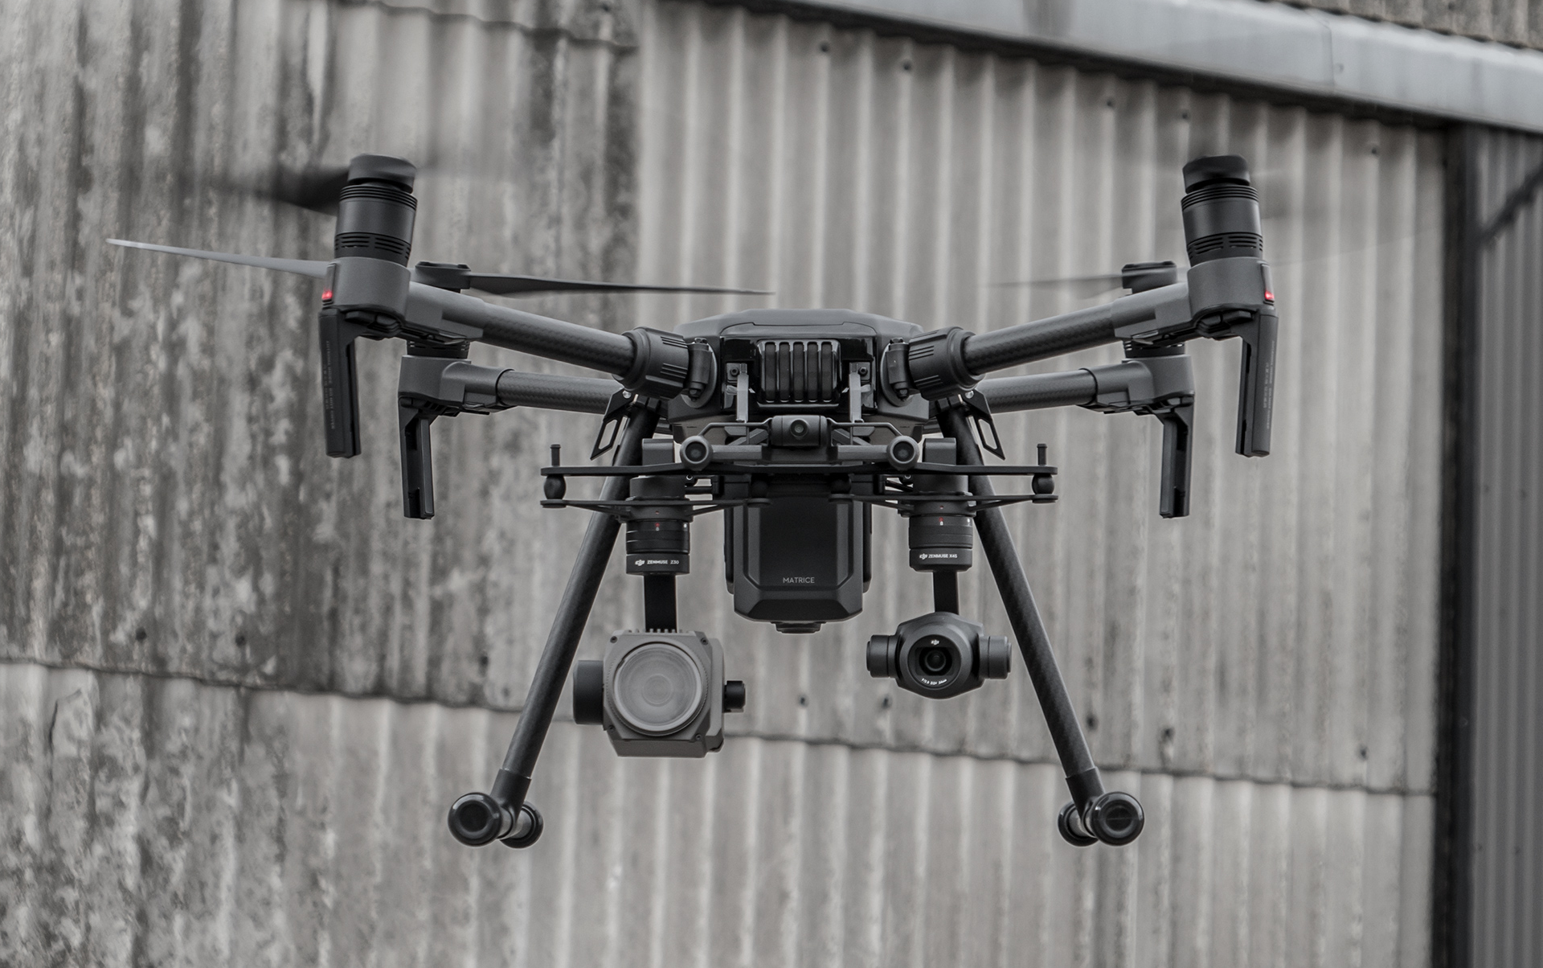
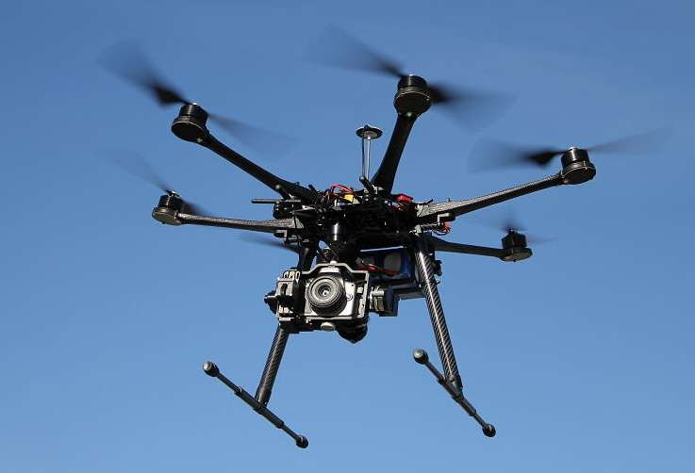
Technical Trades
SPECS | Design 1: Hexacopter | Design 2: DJI
Max Flight Time | 15 - 25 min | 38 min
Software | ArduPilot | DJI SDK
Weight | 10 lbs | 9.9lbs
Portability | Folded: 960x210x200mm | Folded: 716x242x236mm
Obstacle Avoidance | Yes | Yes
Communication Range | 1 -1.5 miles | 4.3 miles
Camera | RunCam & FLIR Duo | Zenmuse XT2
Future Enhancements | Yes | Yes
Weatherproof | No | Yes
Cost | ~$1800 (without thermal camera) | ~$8000 (without thermal camera)

Slide 6
Proposed Final Design to Present to FPL
Hexacopter:
Frame: Tarot T960
Flight Controller: Pixhawk 4
  Comes with a GPS module, built in accelerometer, gyroscope, magnetometer and barometer
Software: ArduPilot, Mission Planner and PX4
  These softwares will allow the creation of predetermined flight plans and autonomous functions
Battery: Tattu 7000mAh 6S 25C LiPo
  6 cell Lithium Polymer battery
Camera: FLIR Duo and Runcam 2
  FLIR Duo will allow for thermal/visual imaging and the Runcam 2 will allow a FPV (first person view)

Slide 7
Prototype: Practice Quadcopter Build
Created to use as practice for programming autonomous flight paths
Mitigates risk of breaking expensive parts during hexacopter validation
Uses an Arduino as the flight controller
Relatively cheap and easier to build than the hexacopter

Slide 8
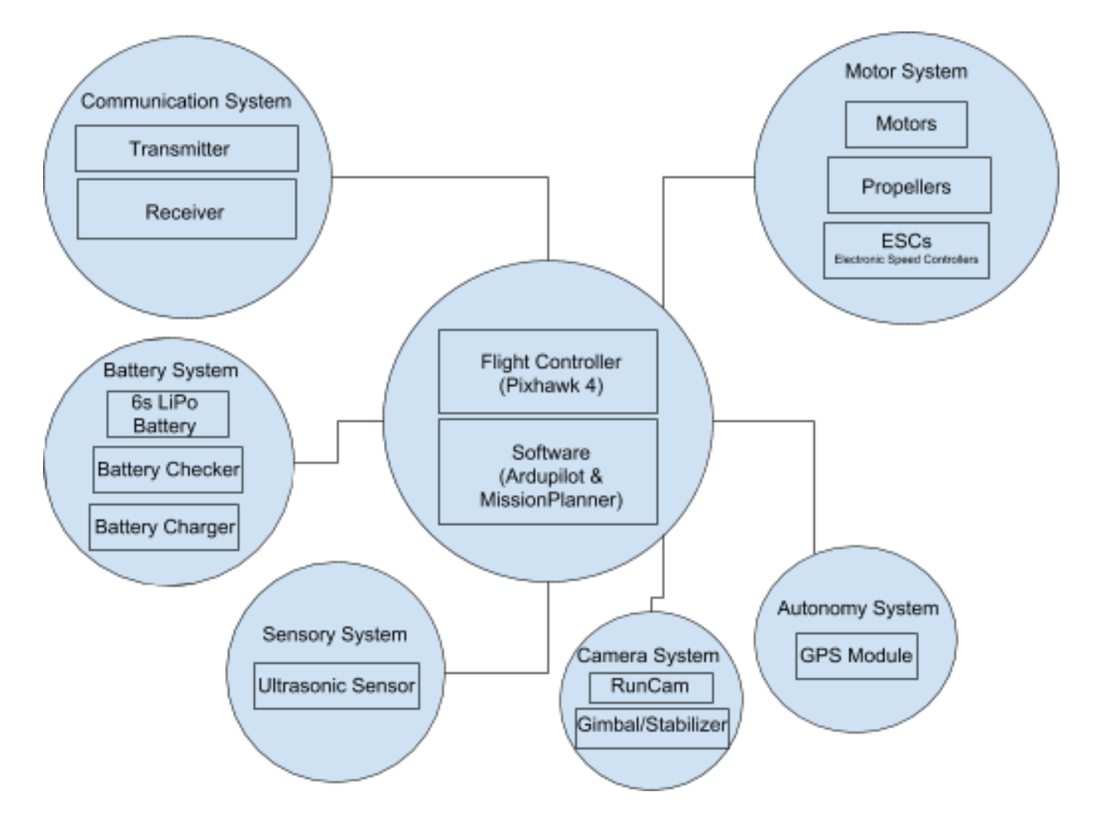
Hexacopter High Level System Diagram

Slide 9
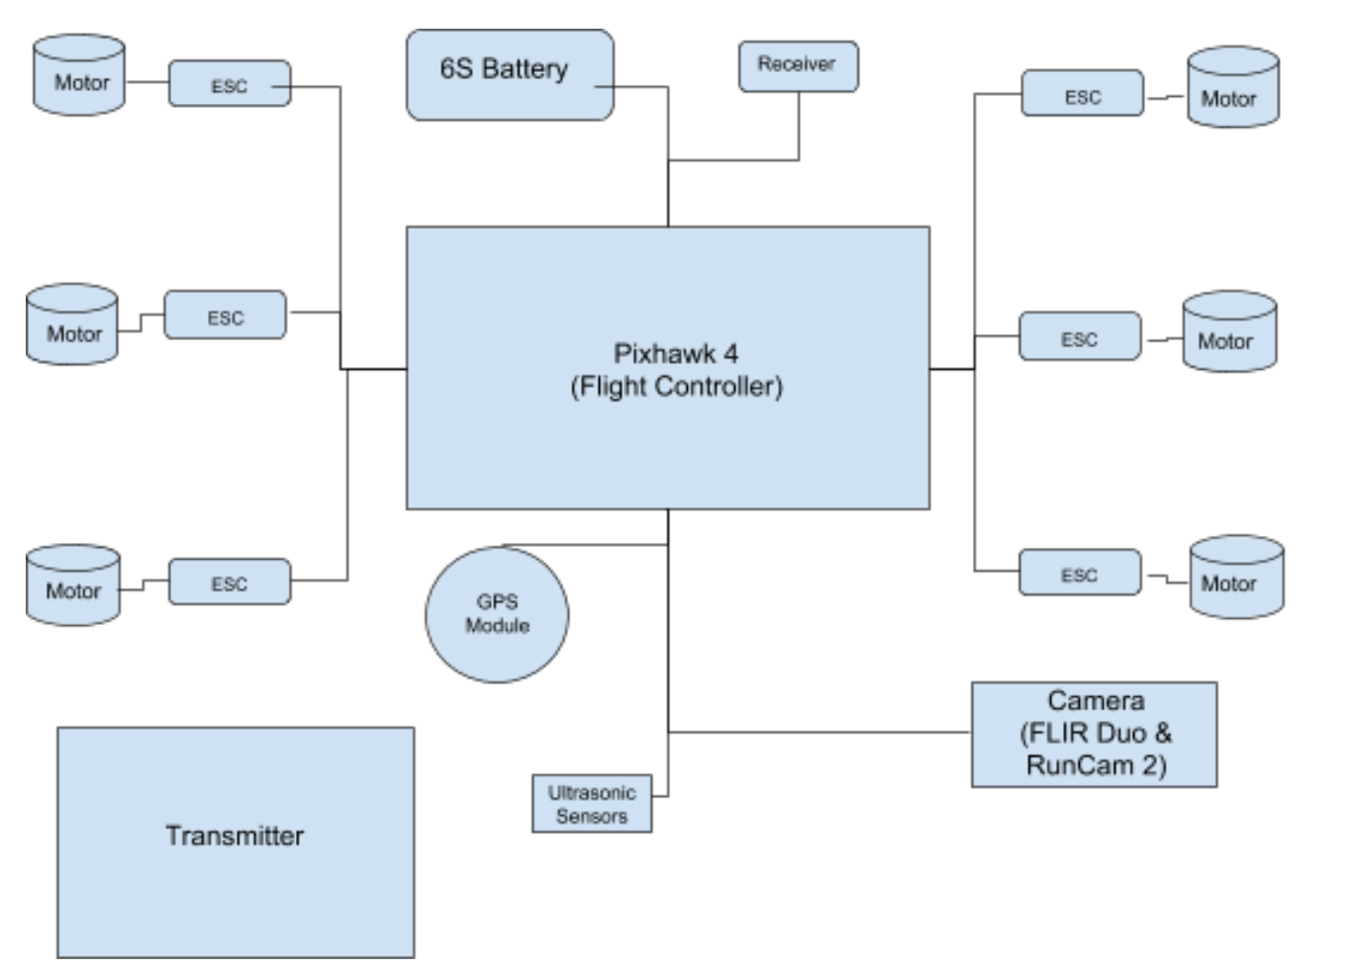
Hexacopter Component System Diagram

Slide 10
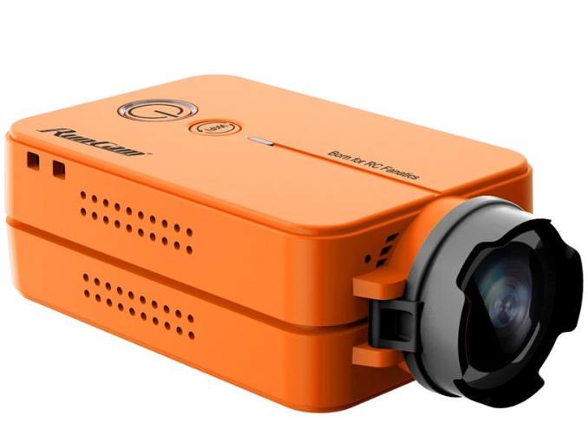
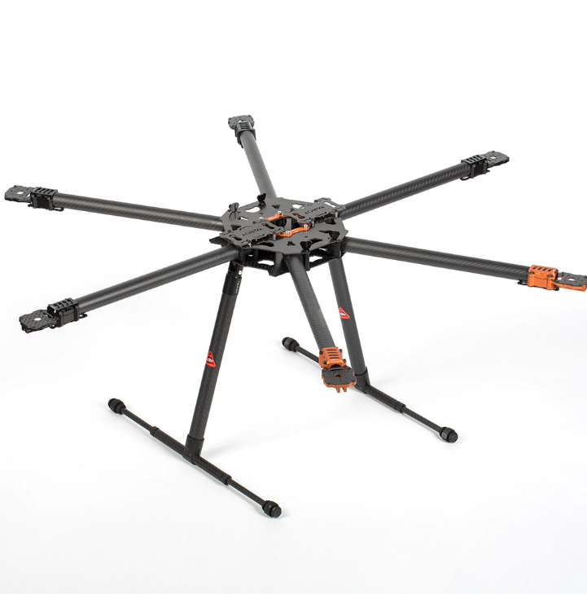
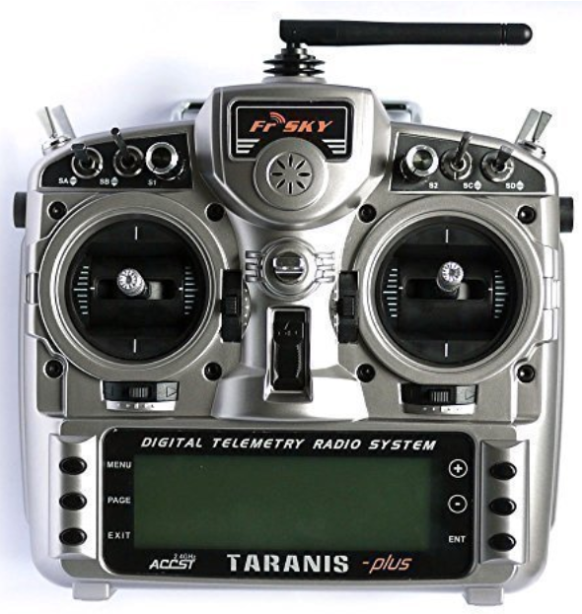

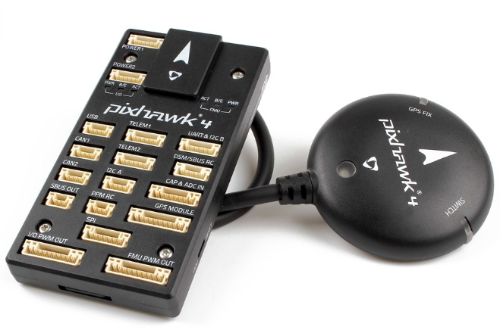
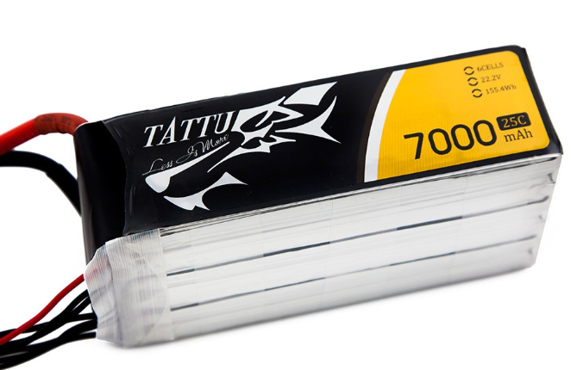
Hexacopter Design Components

Slide 11
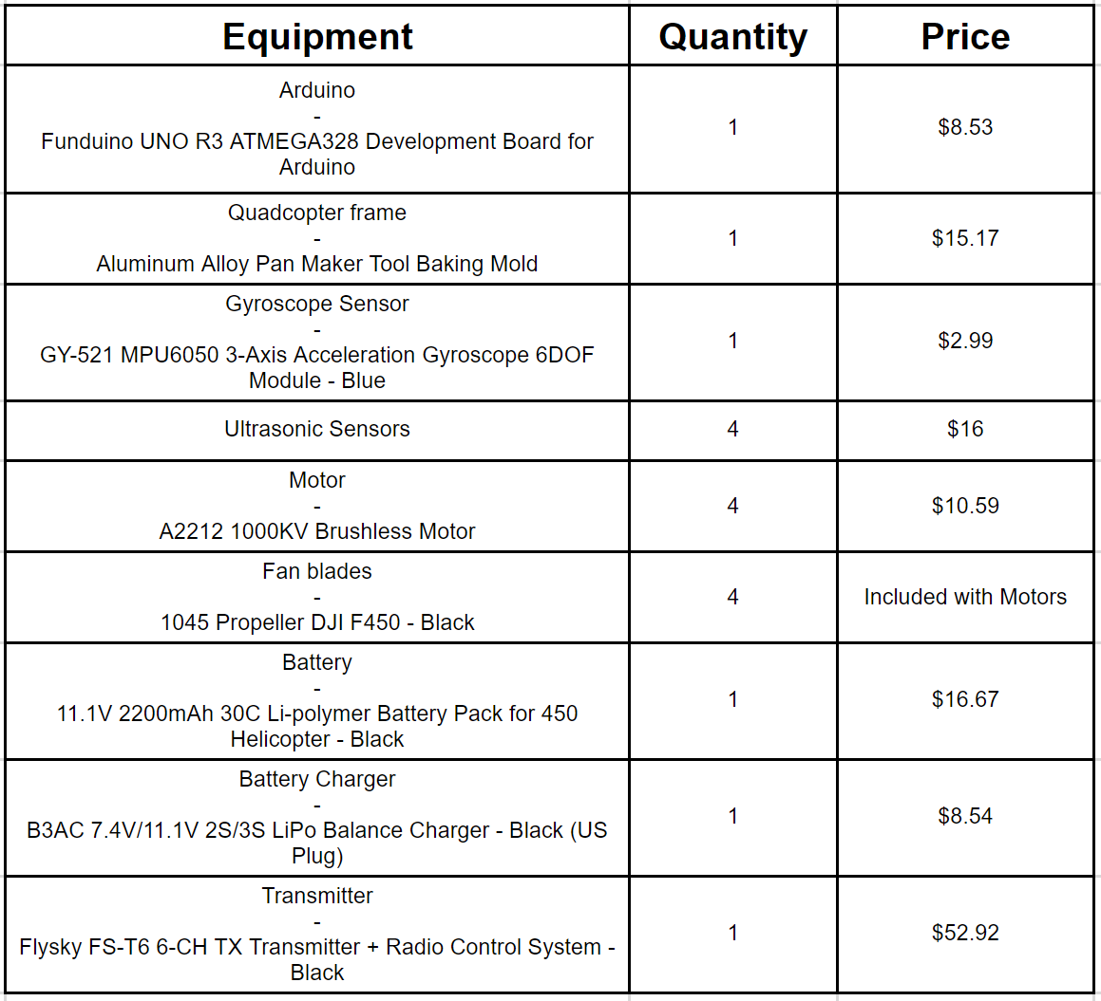
Practice Build Design Components

Slide 12
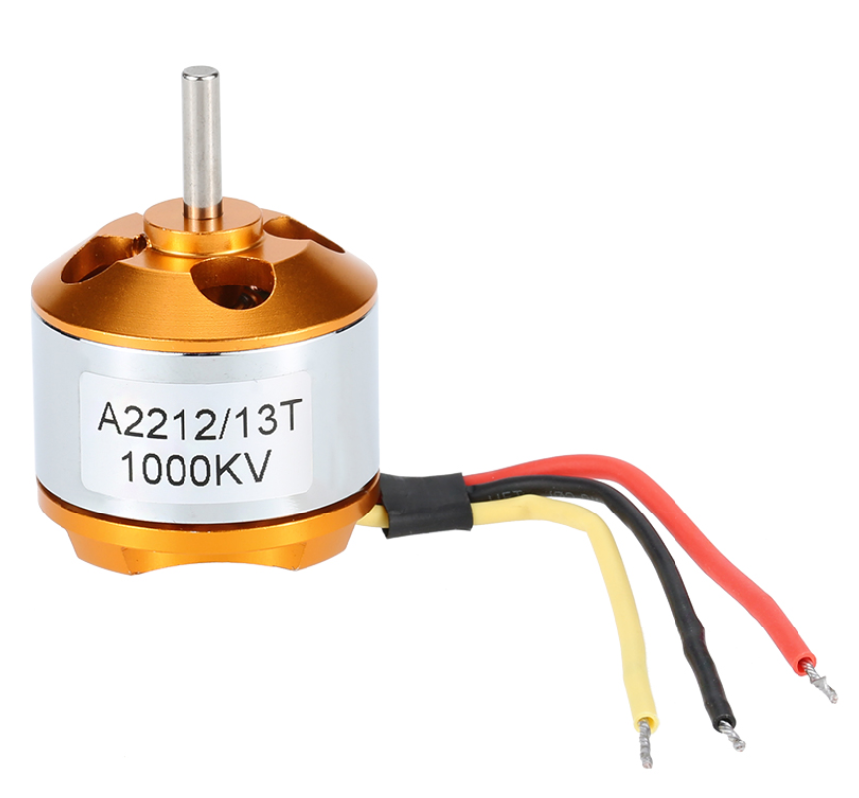
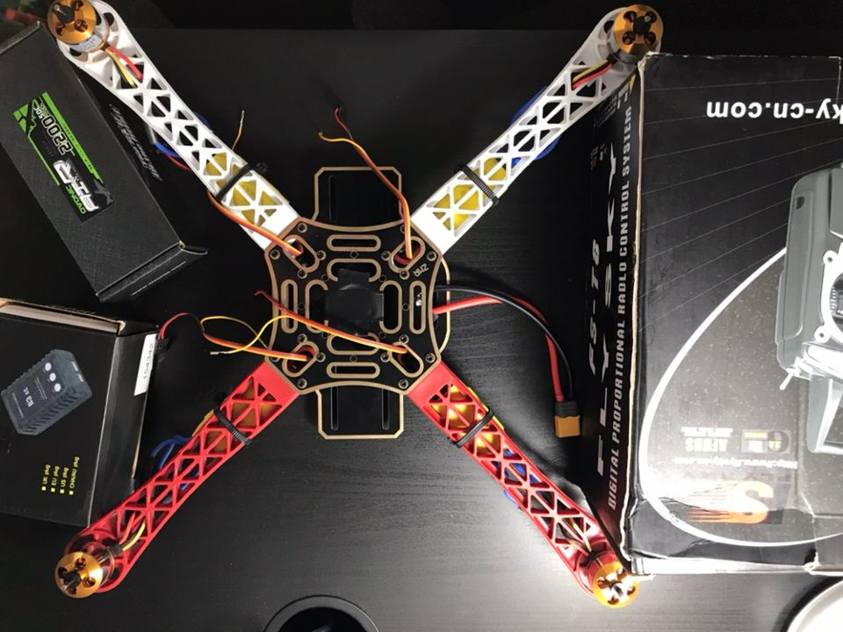
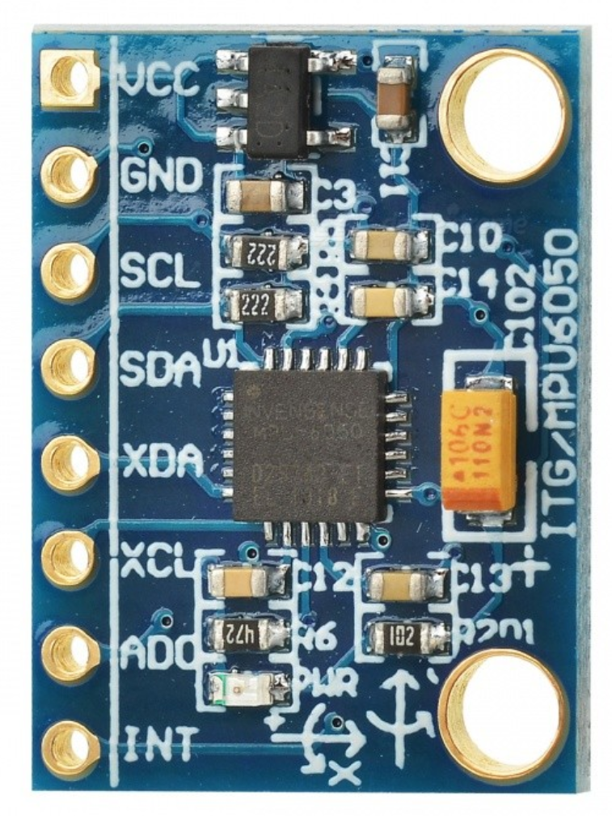
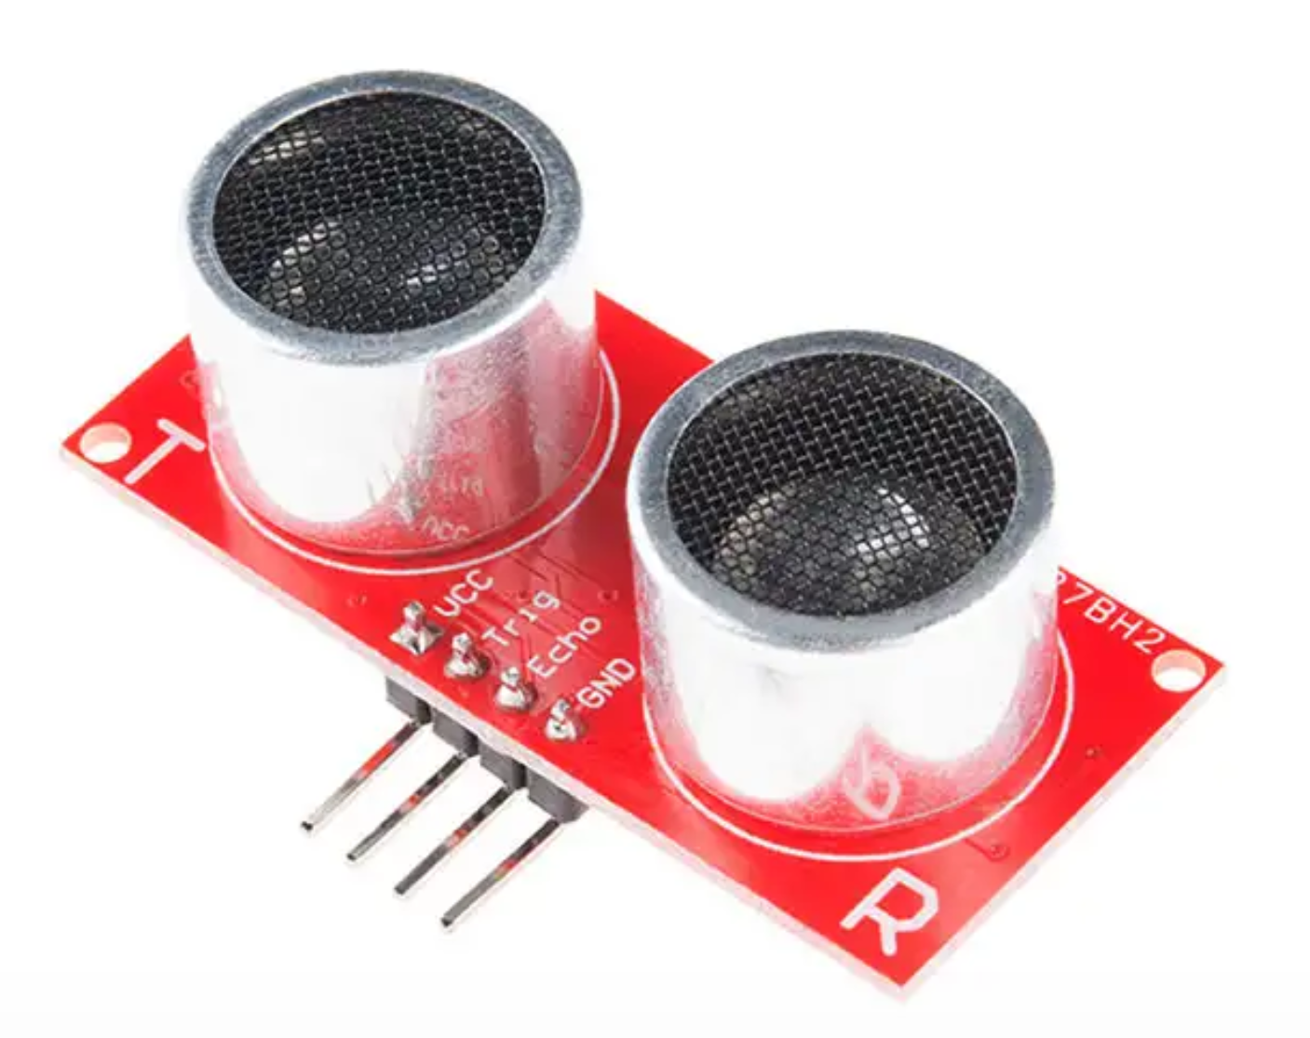
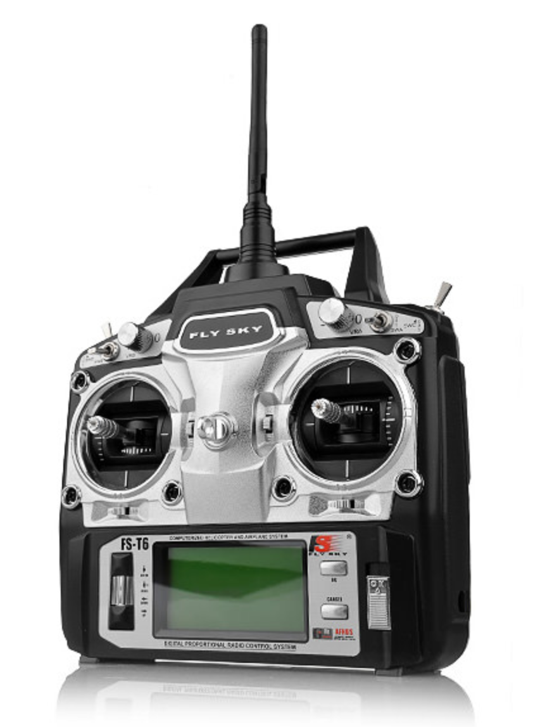
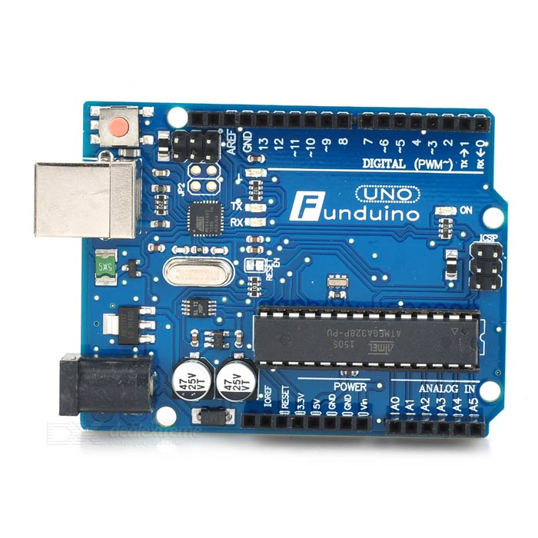
Practice Build Design Components

Slide 13
Autonomous Flight
Flies in a predetermined path along power lines
  Uses Ardupilot platform with an onboard GPS system and gyroscope
Shall remain within line of sight of operator all times (FAA regulations)
Operator shall have the option to assume manual control of the drone at any time
  Manual control with a RC transmitter

Slide 14
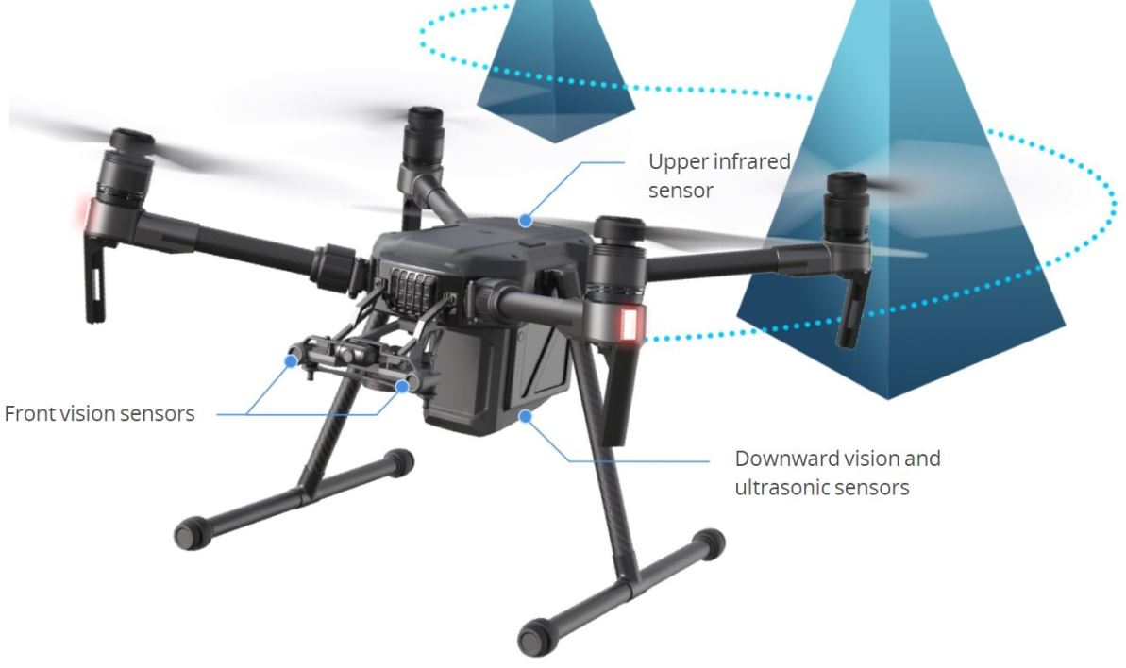
Obstacle Avoidance
Uses onboard ultrasonic sensors
If the drone detects an obstacle, it shall stop
  Possibly have ability to find an alternative route after stopping

Slide 15
Safe Return to Home
The drone shall return home upon either of 2 conditions:
  The battery reaches 60% or less life
  Winds exceeding 20 mph are detected

Slide 16
Battery Life
Long battery life is a design priority
Uses a large 6 cell battery, possible two batteries
7000mAh
High efficiency motors (Low KV)
Sports a light carbon-fiber frame

Slide 17
Imaging and Inspection
Thermal, as well as optical imaging
Will take images of the line every 1 second of flight time
  Images will be saved onboard the drone and transmitted back to base
Camera will be on a gimbal to maintain stability
Will flag events in which detected temperature is outside a set safe range

Slide 18
Risks
Lose track of the drone:
  “Fly-away” event
Component damage during flight:
  Motor(s) burning out, ESC(s) or other parts breaking or stop functioning
Communication:
  Electromagnetic Interference (EMI) could interfere with communication
Schedule:
  Time may not be enough for meeting all the requirements

Slide 19
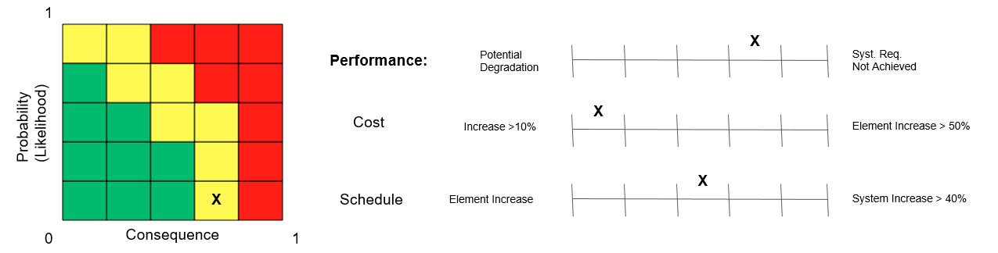
Risk Analysis and Mitigation Plan
“Fly-away” event:
  Keep the drone in communication range and line of sight
Component damage during flight:
  Perform on-time maintenance and keep track of parts and part life
EMI:
  Keep the drone at a safe distance away from the powerlines
Time:
  Keep schedule updated and organized and complete tasks on time
Notes:
Lose track of drone
Obstacle collision
“flyaway” event - bad communication connection may leave drone rogue
Wind/Weather affecting flight
Mitigation plan: keep the drone in sight and in communication range
Battery run out during flight
Mitigation: “Return home” protocols
Broken motor/ESC/drone parts
Mitigation: buy extra parts
Scheduling/time/resources
Meeting primary & secondary design goals
Security breaches of communications
Jam communication
Mitigation: shielding
Likelihood: unlikely
Electromagnetic Interference
From transmission lines
Mitigation: Keep away at least 1 meter from the transmission line
FAA Standard: DO-160G document - Electromagnetic Compatibility
Use the ultrasonic sensor and code

Slide 20
Validation
Do a demo flight:
Autonomous flight:
  Make the drone fly certain predetermined flight paths autonomously such as a circular loop while increasing height, lawnmower path, etc
Obstacle Avoidance:
  Fly the drone towards an obstacle such as a wall to see if it stops
Safe return to home:
  Keep flying till 40% of the battery is consumed to see if drone returns to home
Imaging and Inspection:
  Instead of power lines make the drone mission to fly a predetermined path and take pictures and inspect a tree or a street light

Slide 21
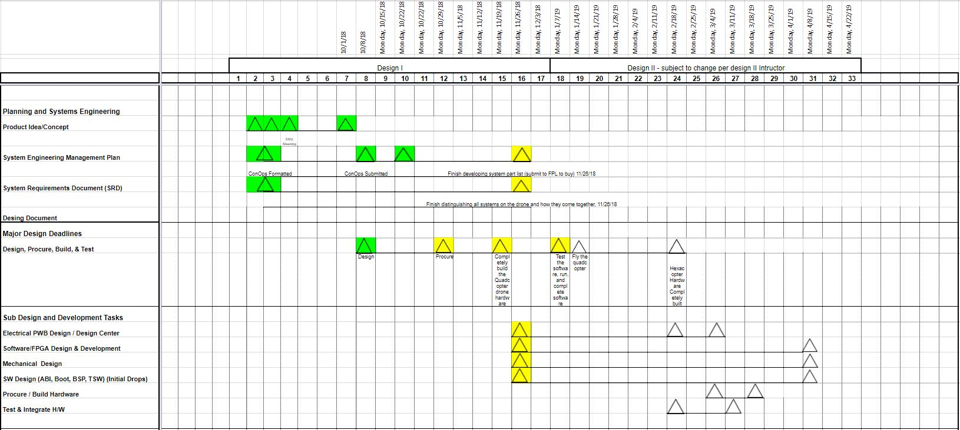
Schedule

Slide 22
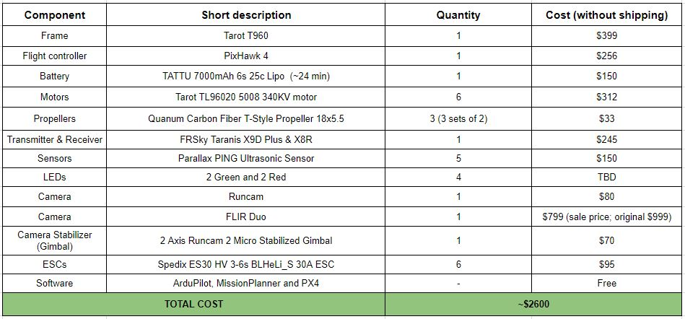
Bill of Materials

Slide 23
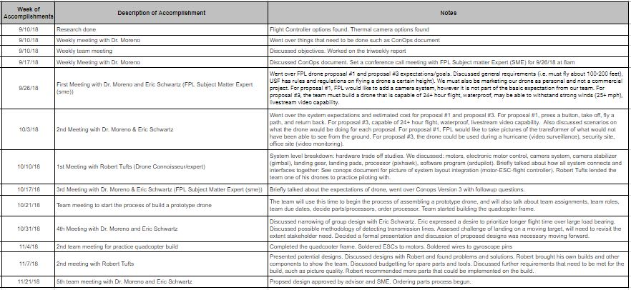
Weekly Accomplishments

