Slide 1

CDR - Critical Design Review
Autonomous Drone for Powerline Inspections
University of South Florida
College of Engineering - Electrical Engineering

Slide 2
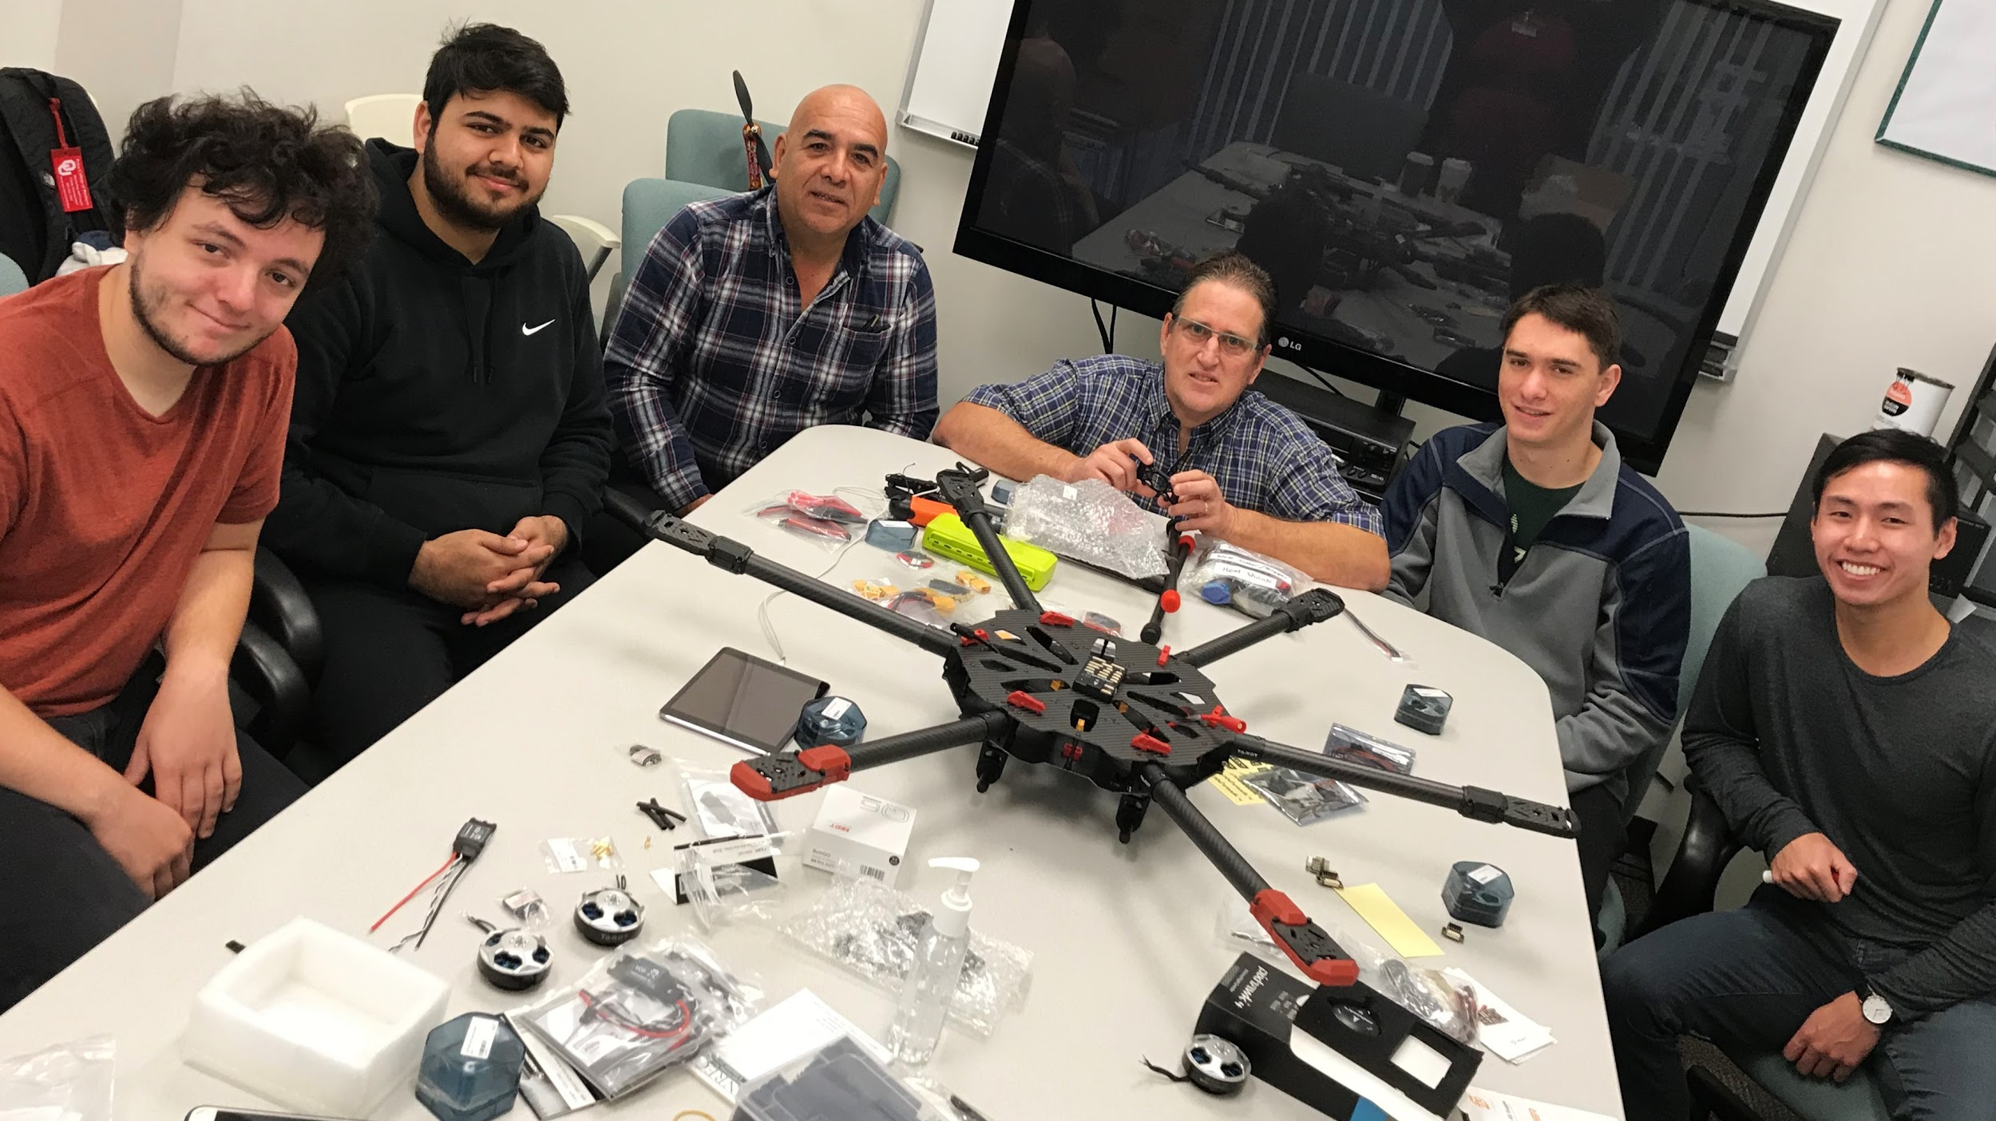
Team Members
Team Advisor & Mentor:
Dr. Wilfrido Moreno
&
Robert Tufts
Team Members:
Talha Bin Amir
Joseph Ellis
Adam Woughter
Brian Vu
Sponsor:
Florida Power & Light
SME: Eric Schwartz

Slide 3
Team Member Roles
Talha:
Setting team goals
Parts management - Ordering parts
Hardware development - Frame build, wires, connectors, motor and ESC installation
Autonomy system - Qgroundcontrol, flight controller and telemetry setup and calibration
Joey:
Hardware development - Soldering, wires and connectors, motor and ESC installation
Battery System - Building custom battery charging connectors, setting up battery charger
Thermal camera imaging system
Adam:
Motor and battery components research
Camera system - RunCam 2 and vtx integration for FPV (first person view) through goggles
Brian:
Communication system - Transmitter/receiver communication, flight models (opentx)
Website development

Slide 4
Project Description
Power lines are at a high elevation and cannot be fully inspected from the ground:
  Power companies have to use helicopters to inspect the lines from the air, which is obviously very expensive
  Around $200/mile and only 8 miles can be inspected per day
Powerline inspections are also dangerous:
  2 casualties and 2 injured in New York and 2 casualties in Ohio last year due to the helicopters crashing
In recent years, power companies have moved to using drones for these inspections:
  All drones currently used are manually controlled.
With our autonomous drone design, power companies will save money and time by simply deploying an autonomous drone and inputting the area that needs inspection.:
  Cost of the drone will be paid for in two days and no humans should be at risk when our drone is inspecting.
There are also lots of other miscellaneous advantages of using our drone:
E.g. Pulling cables in inaccessible areas, reduced time for inspection, full view of all quadrants, etc.

Slide 5
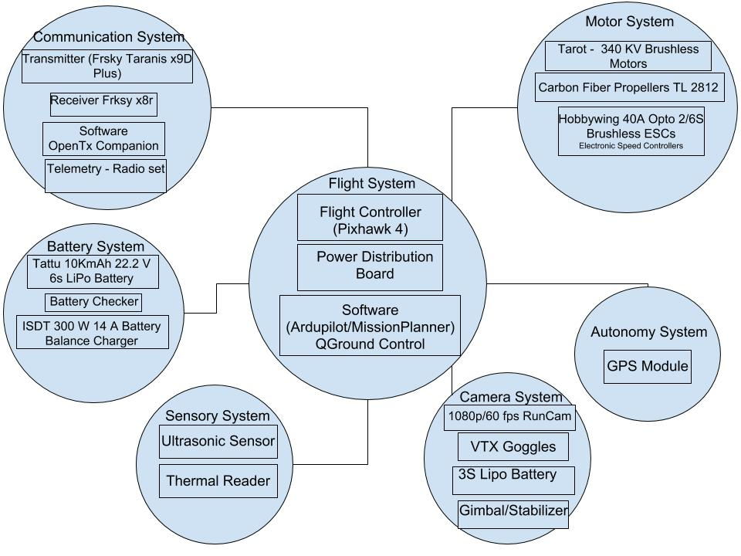
High Level Systems level Design

Slide 6
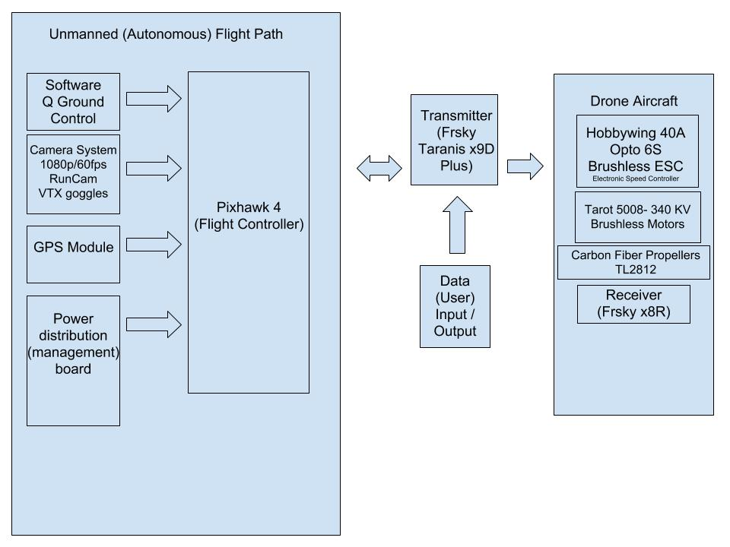
Data Flow Diagram

Slide 7
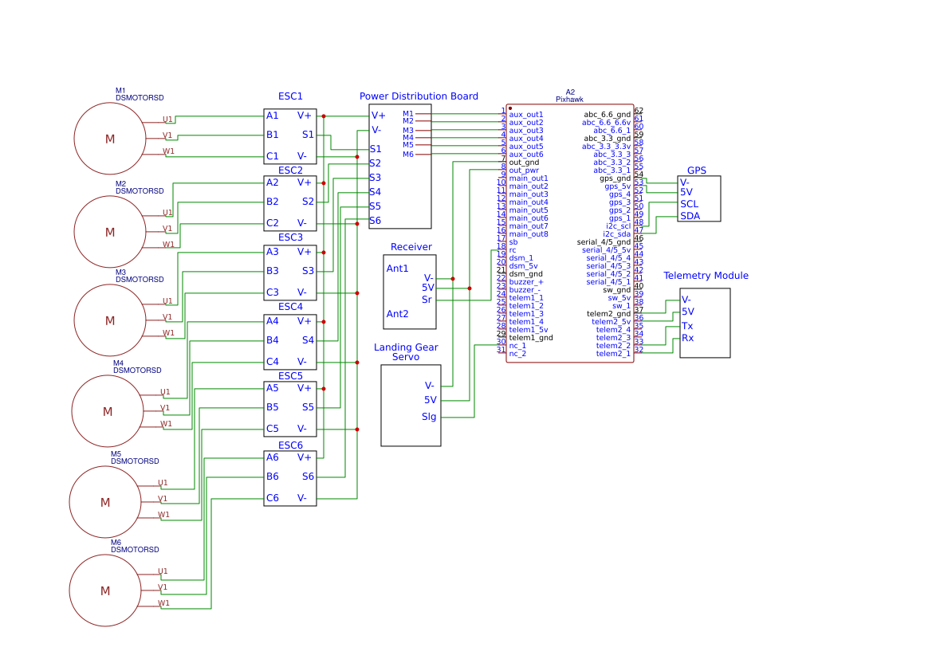
Circuit Design

Slide 8
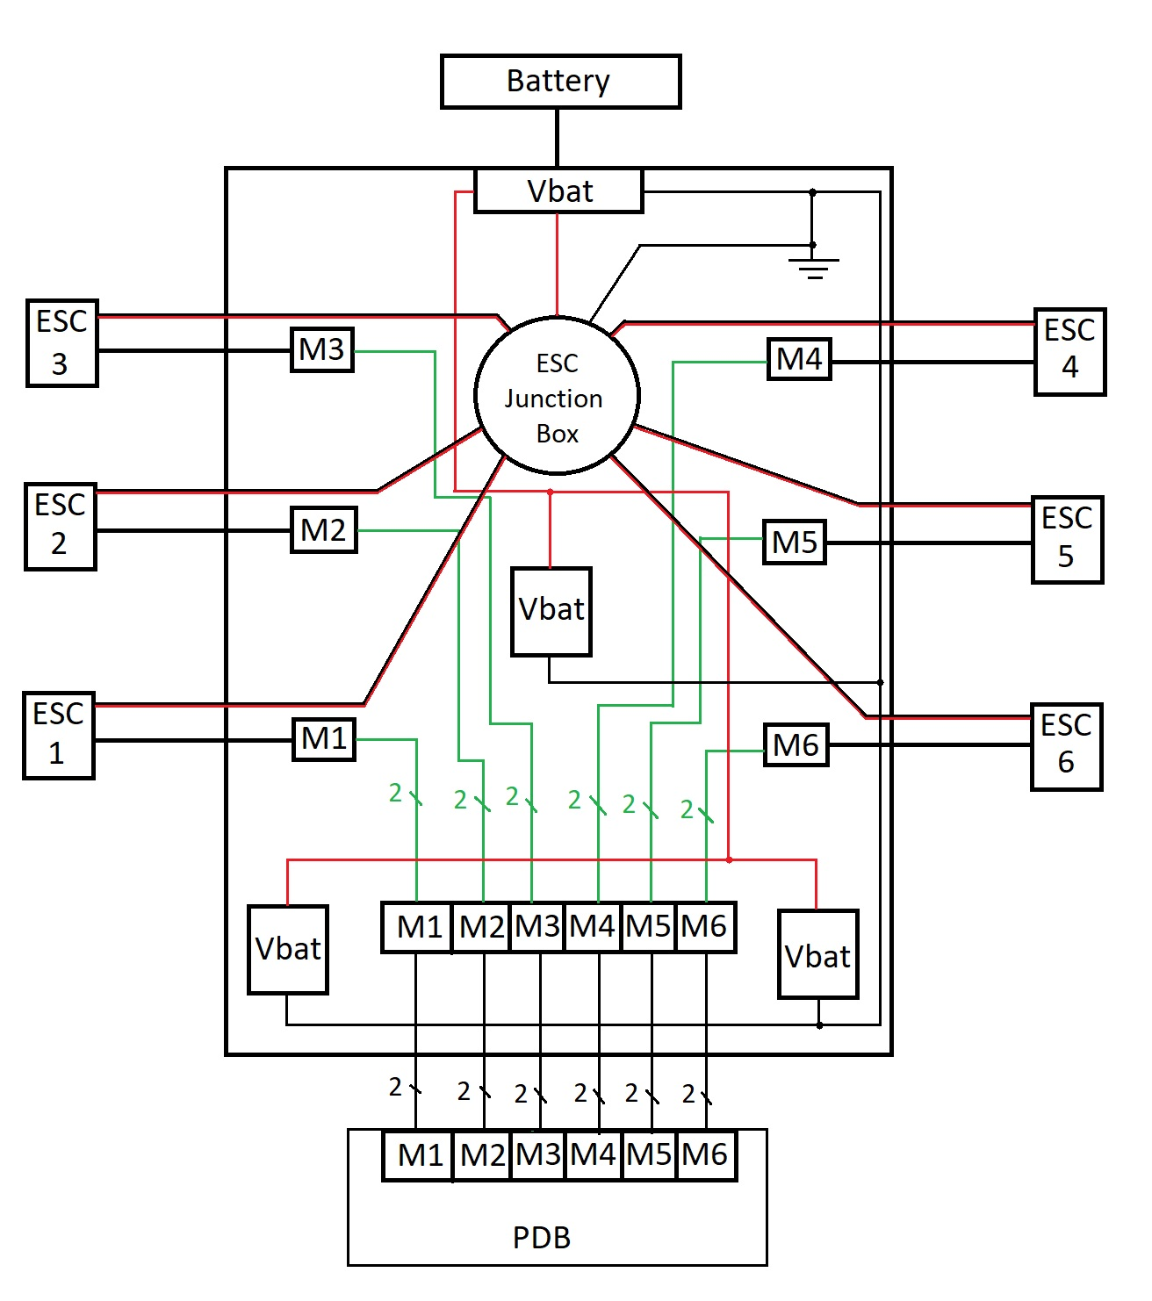
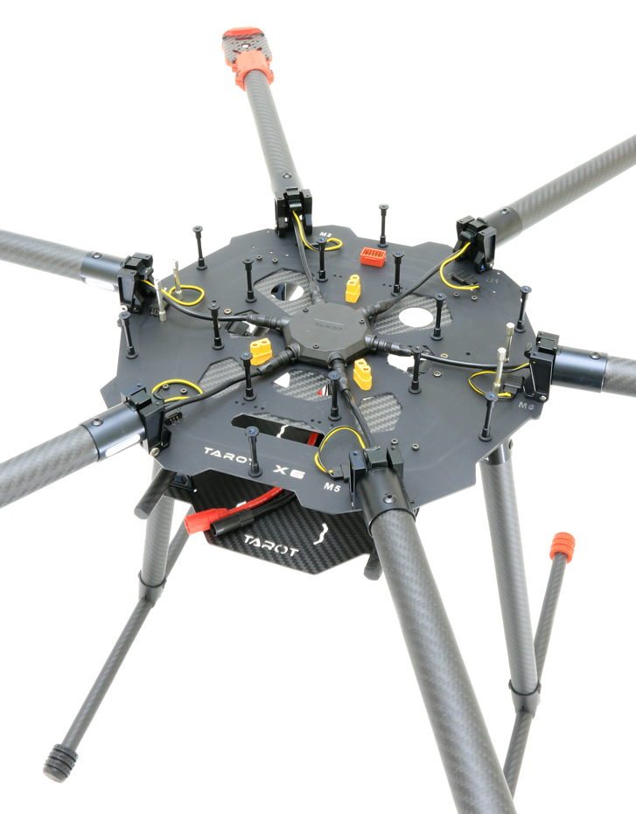
PCB Circuit

Slide 9
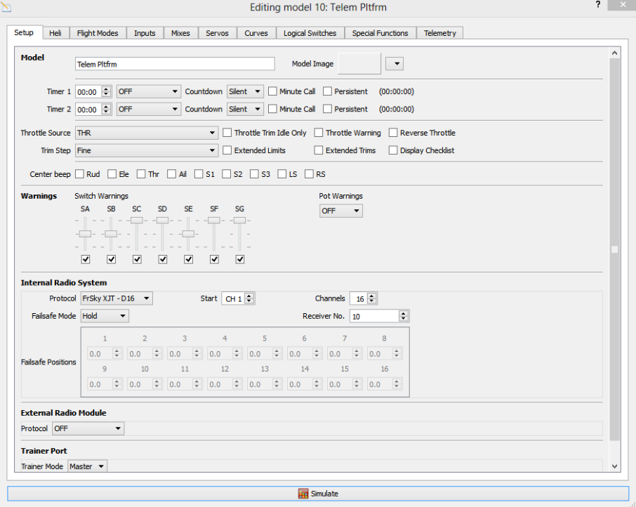
Software Diagram Communication System
Motor controls
Transmitter Communication
Receiver communication
Open Tx Companion (Model Building)
Special functions (stabilize, landing gear)
Flight modes / channels
Aileron, Thrust, Elevate, Rudder

Slide 10
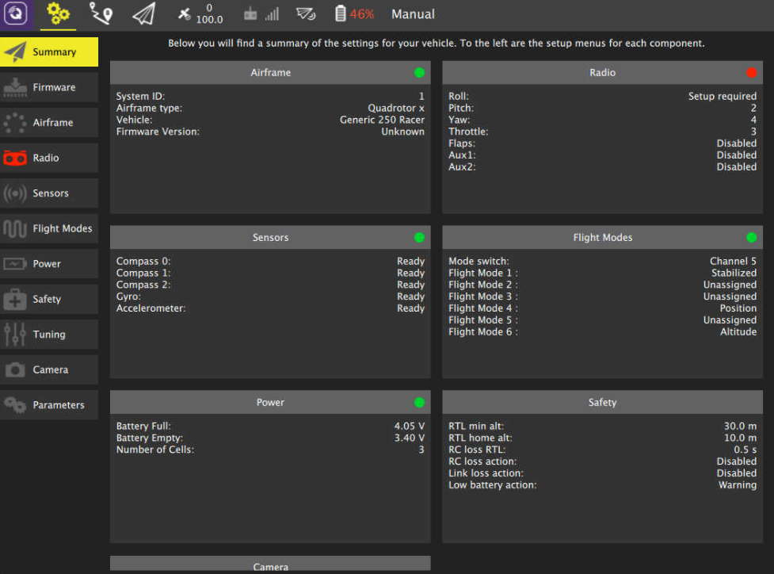
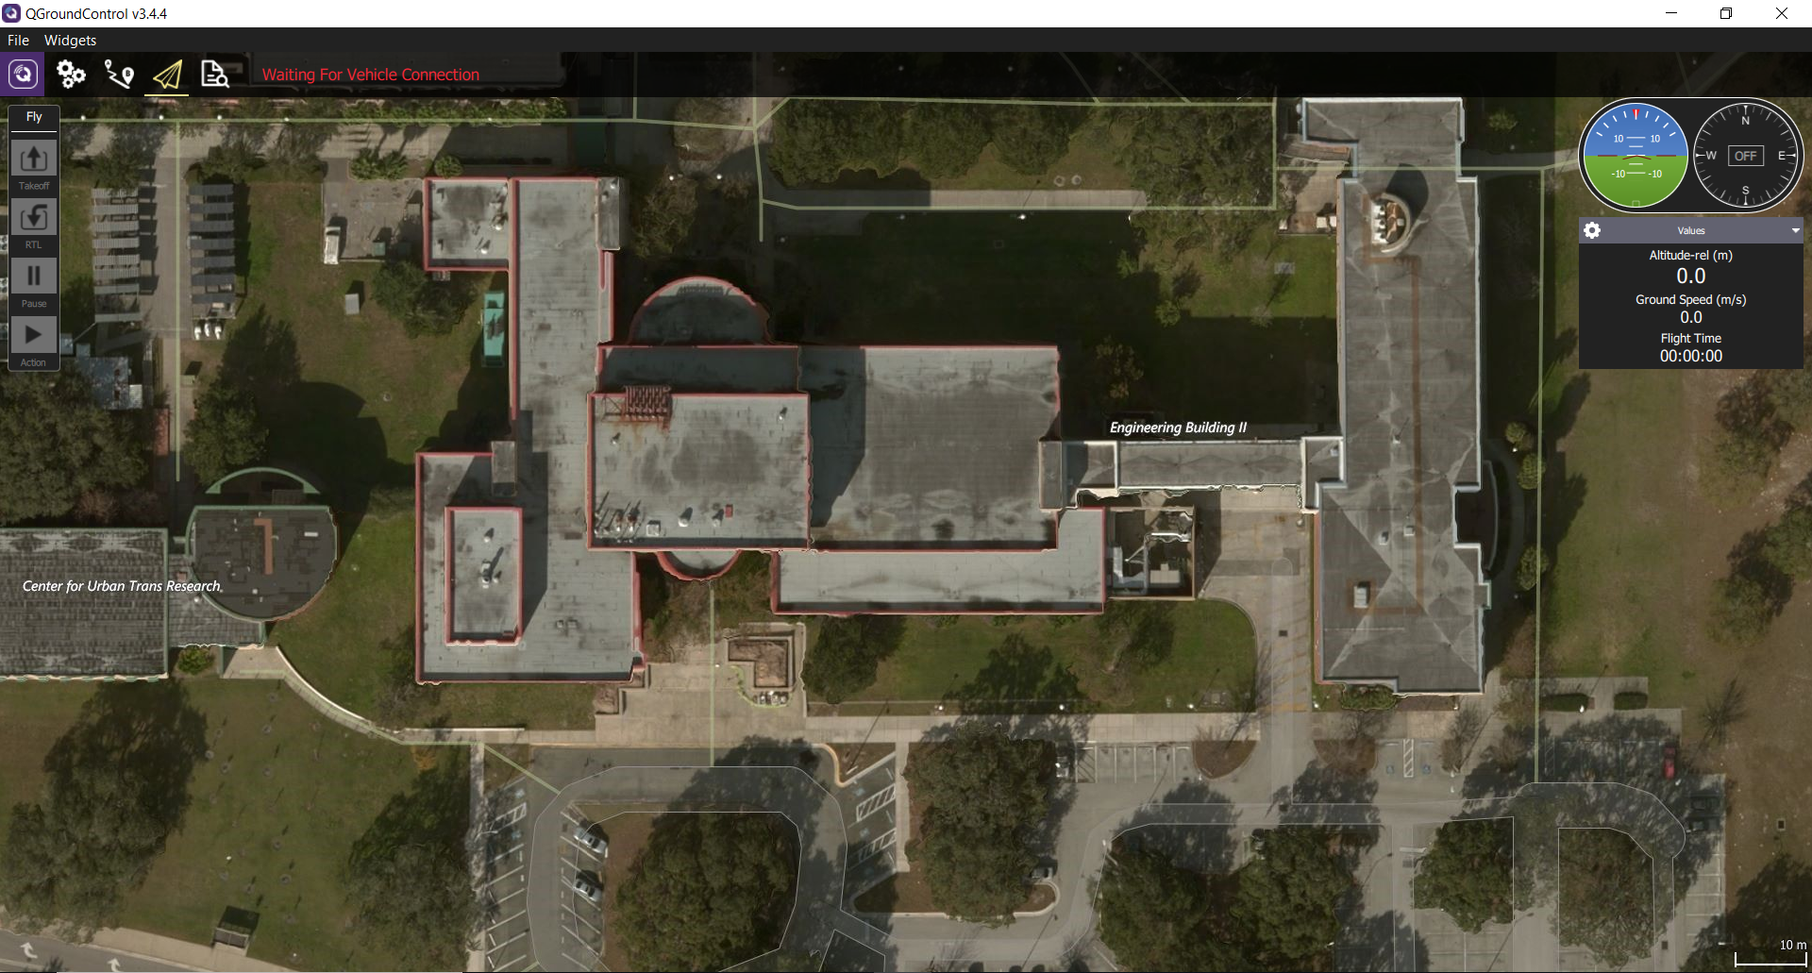

Software Diagram Flight & Autonomy System
Q Ground Control
Pixhawk - Flight Controller
Flight Mode
Communication System
Flight System
Autonomy System
OpenTx software
Telemetry
Battery, Sensors, Camera, Motors, Power, Safety
GPS location system
Transmitter
Receiver
Radio

Slide 11
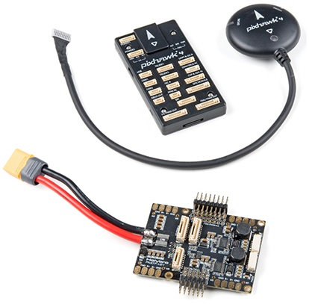
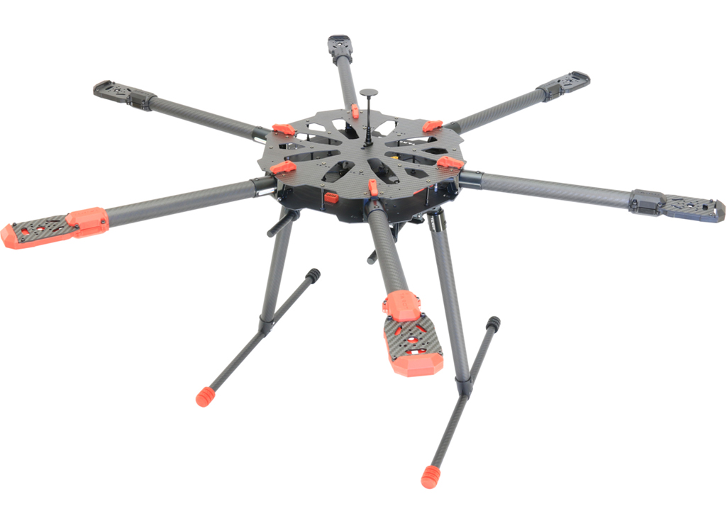
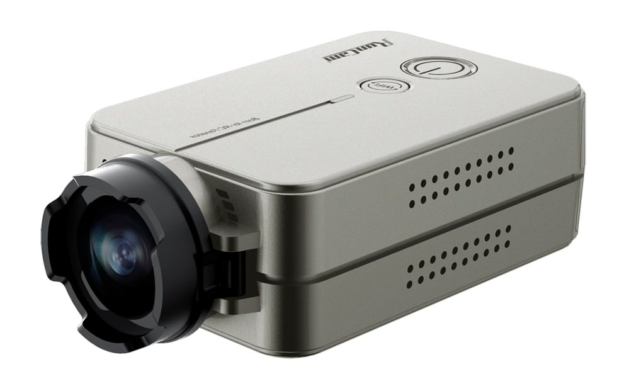
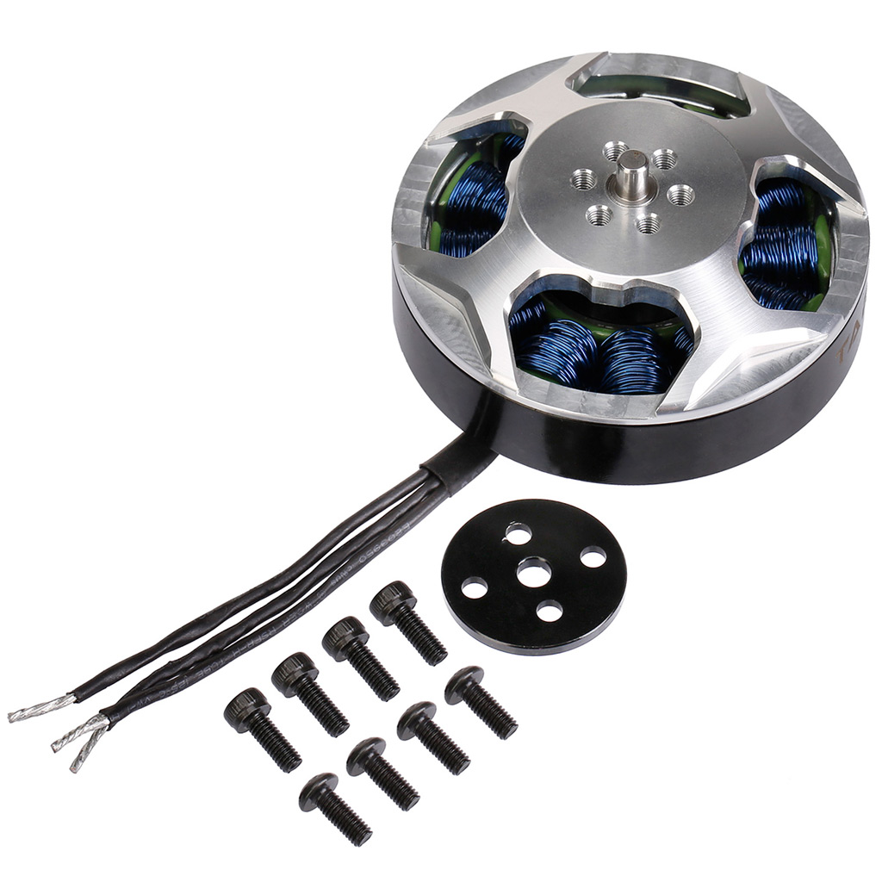
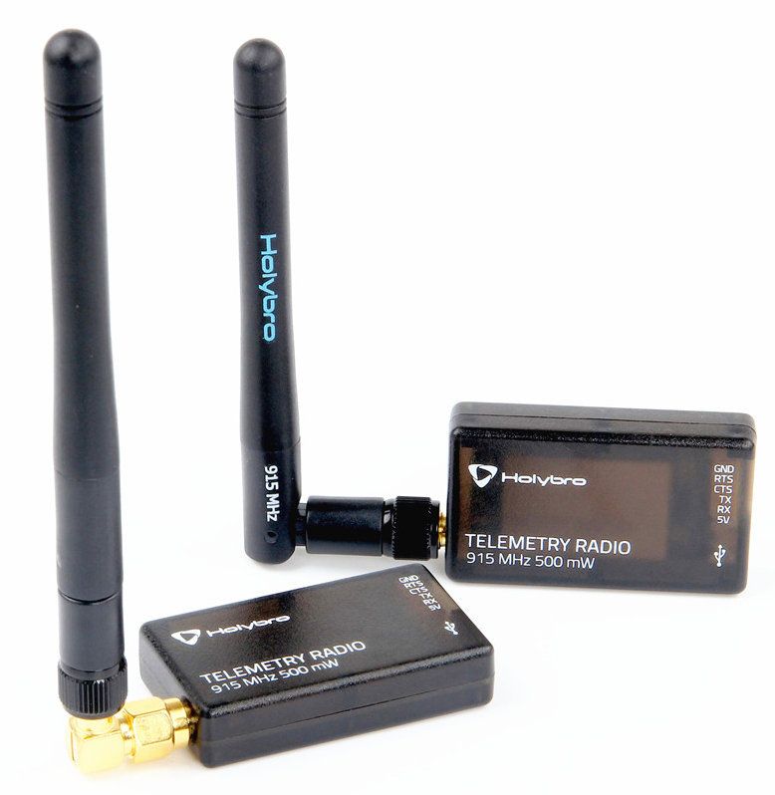
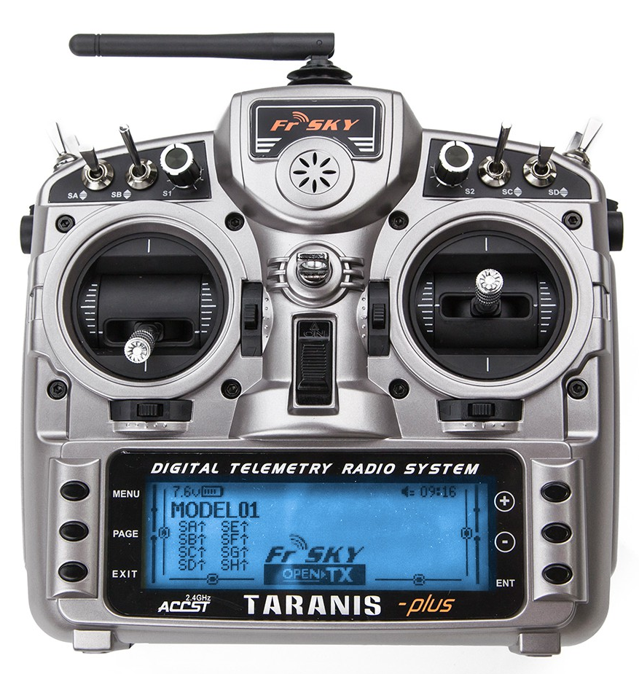

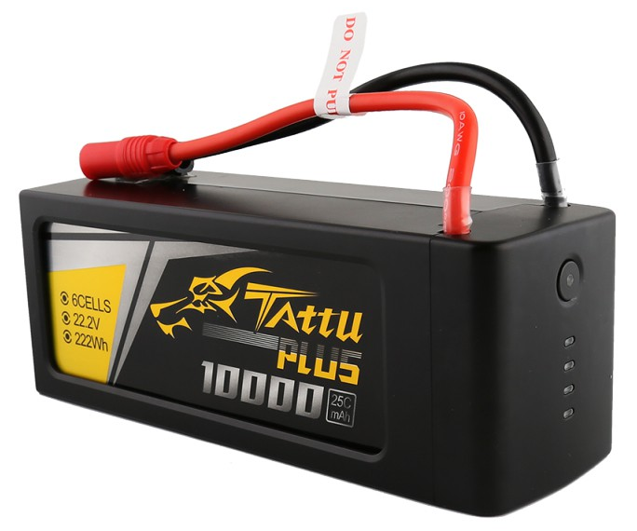
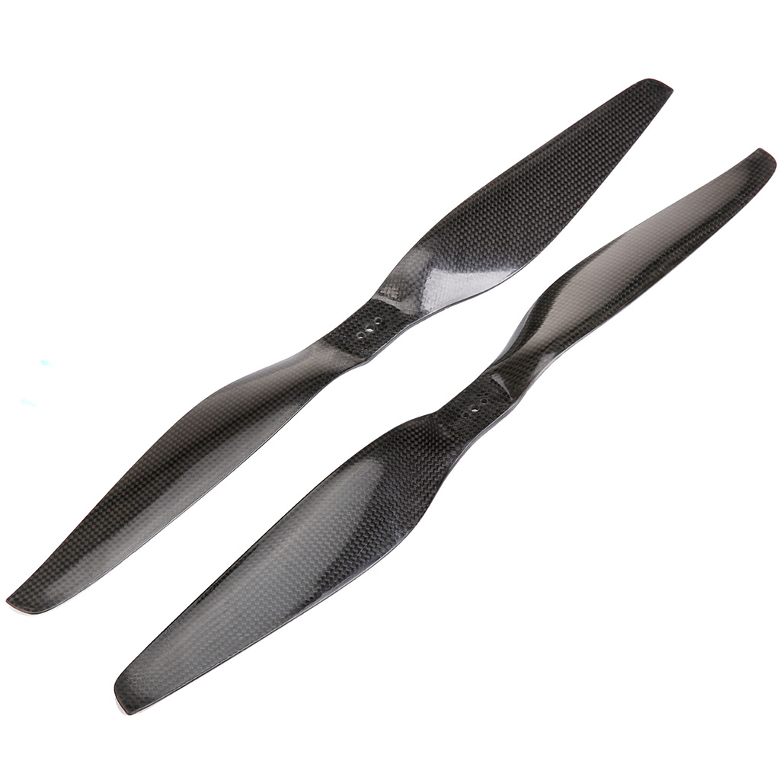
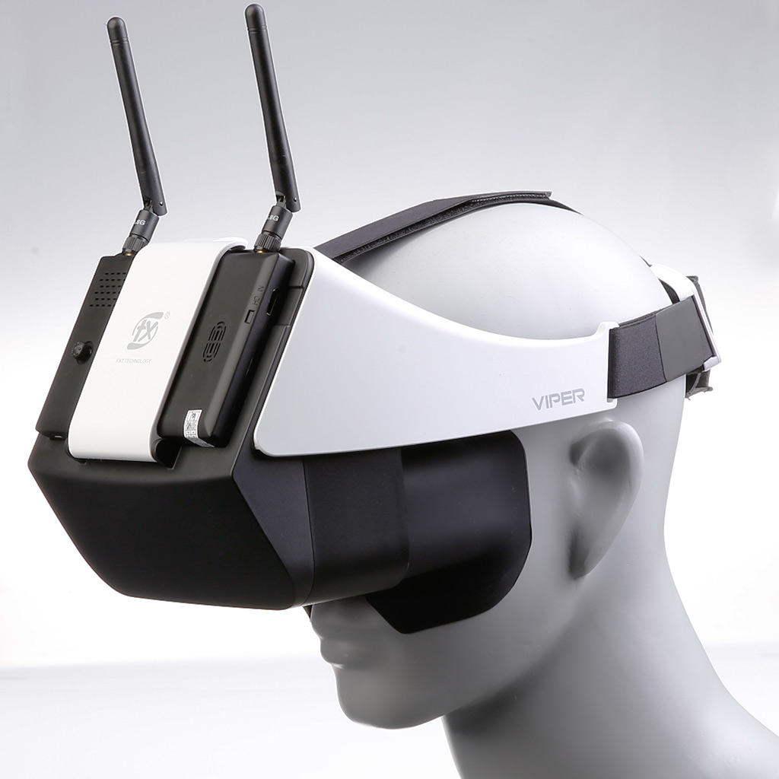

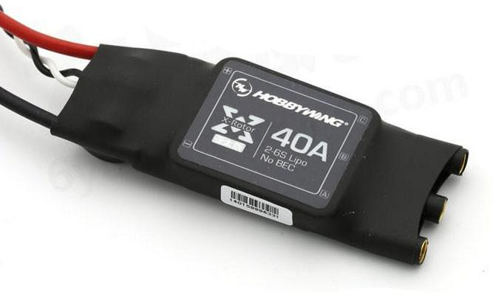
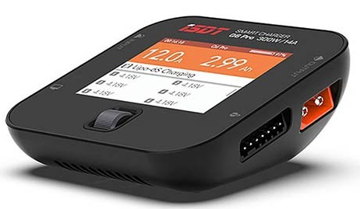
Components
Tarot x6 PCB Frame
Frsky Taranis x9D Plus Transmitter
Frsky x8R Reciever
Holybro Telemetry Radio V3
GPS Module
Tattu 6S 10000mAh 22.2V Lipo Battery
RunCam 2: 1080p/60fps FPV camera
FXT Viper FPV Goggles
Tarot 5008 340 KV Brushless Motors
Hobbywing 40A Opto 6S Brushless ESC’s
Power Distribution Board
Carbon Fiber Propellers
ISDT Q6 ProBattGo 300W 14A Battery Balance Charger

Slide 12
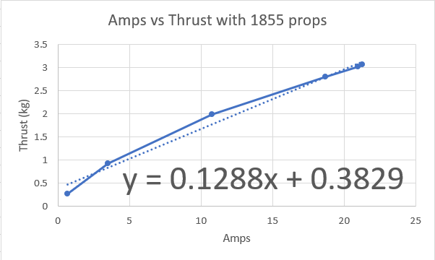
Thrust to Weight Ratio Calculation
Max battery amps = 70A
70/6 = 11.67A per motor
Thrust per motor= 0.1288(11.67)+0.3829= 1.89 kg
Total thrust = 6*1.89 = 11.31
All up weight = 5.7 kg
Thrust to weight ratio = 11.31/5.7 = 1.98

Slide 13
Battery Life Calculation
Thrust to hover = 5.7kg, thrust per motor = 0.95
Current draw (per motor) = (0.95 - 0.3829)/0.1288 = 4.4 A
Total current draw = 4.4*6 = 26.4 A
Battery life = (10 Ah / 26.4 A) * 60 = ~ 22 minutes

Slide 14
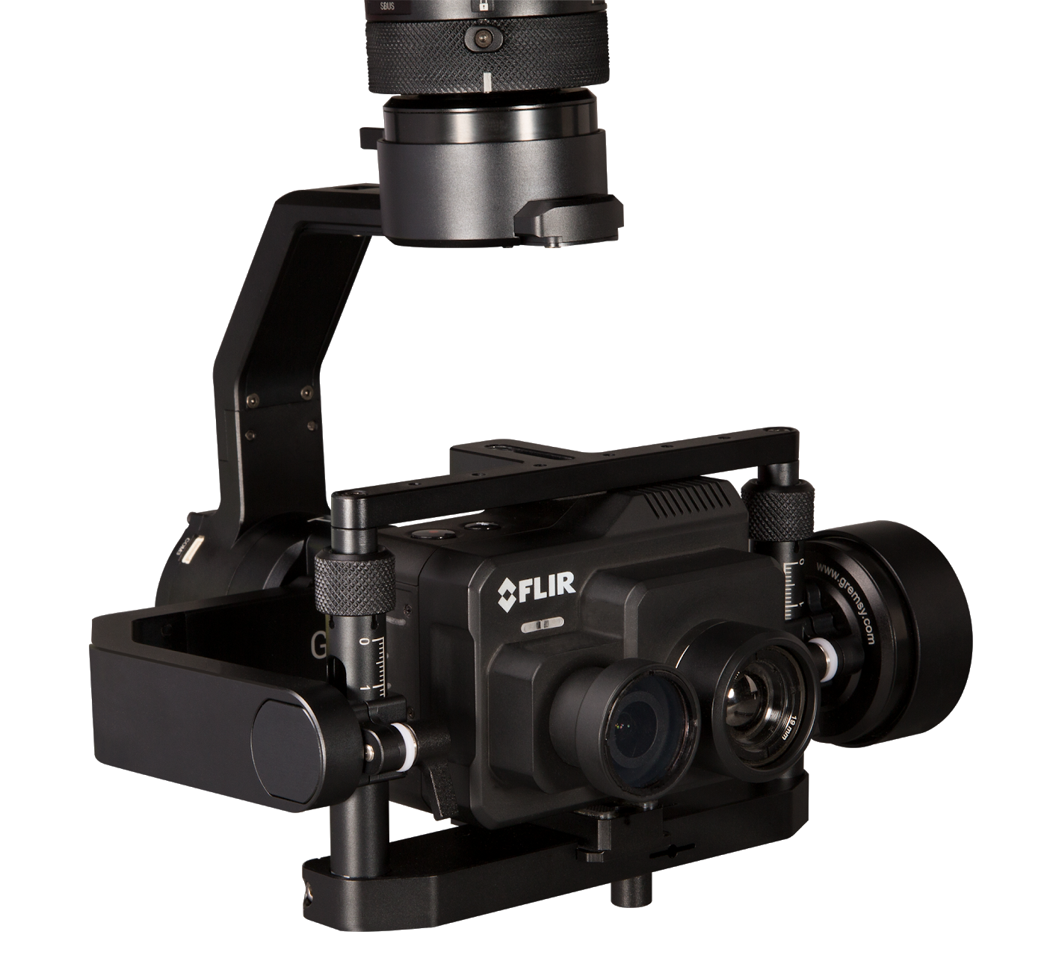
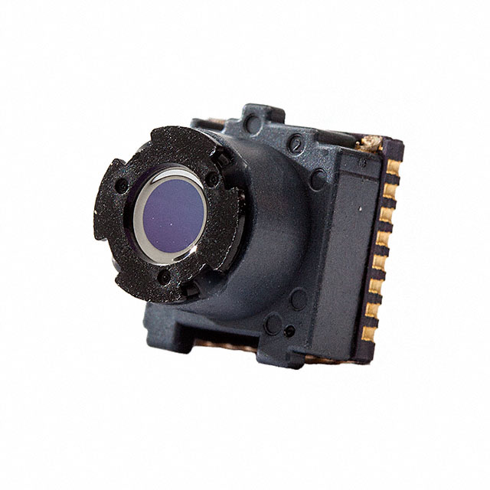
Thermal Camera
FLIR Duo Pro R:
  ~$8,000 (Some older models such as the FLIR Duo are ~$2,000)
  4K Color, 20 fps:
    2 microSD cards: one for video and one for images
  Built in sensors for image geo-tagging
  When final design is being used, this is the camera that will be attached
FLIR Lepton:
  $300
  8.6 fps
  Size of a dime
  For proof of concept we will be using this controlled by a Raspberry Pi

Slide 15

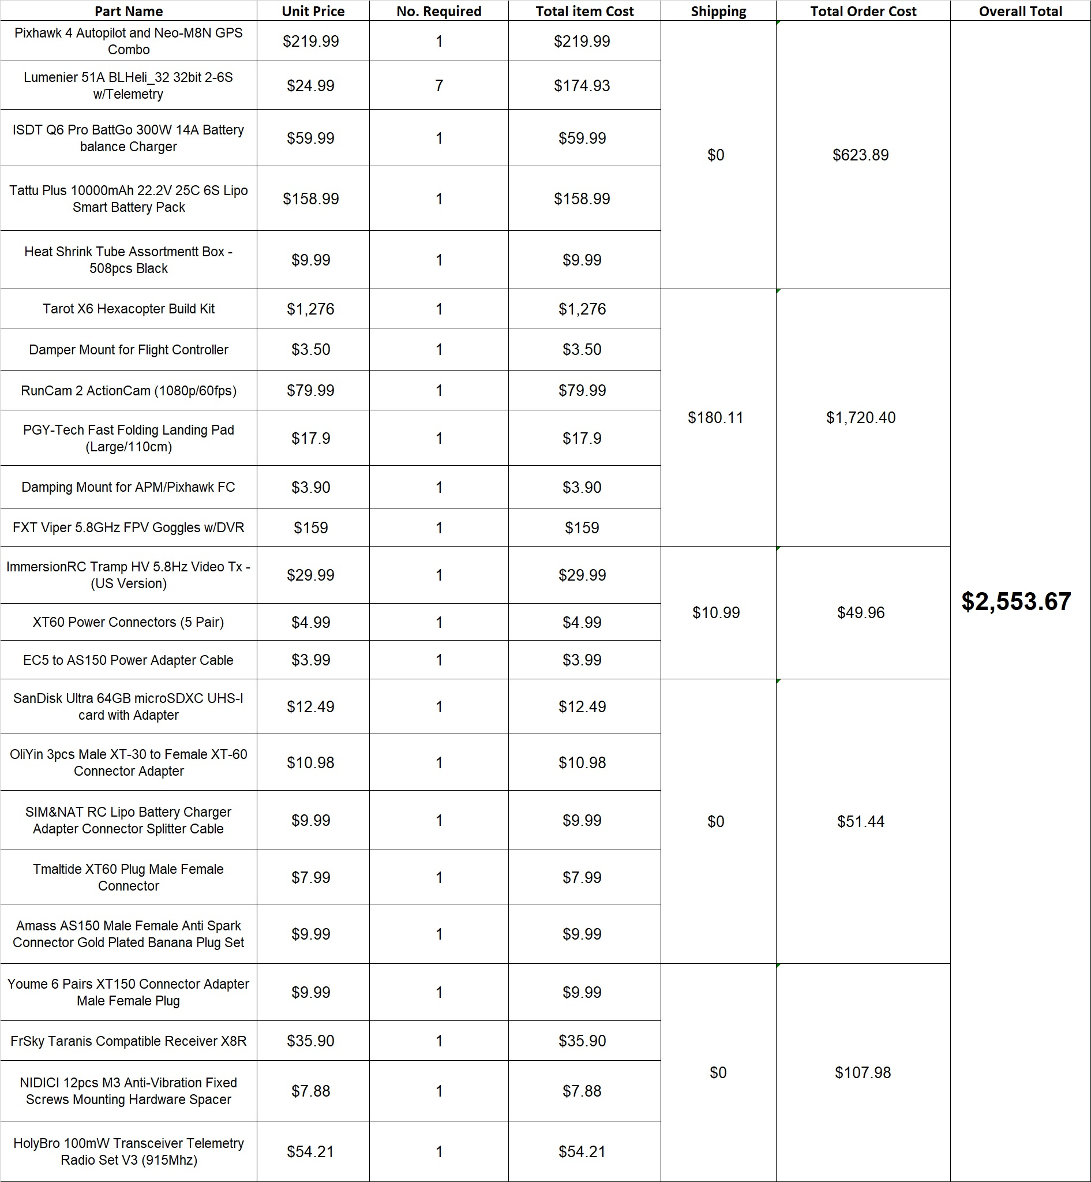
Bill of Materials

Slide 16
Schedule
 |  | Week 1 | Week 2 | Week 3 | Week 4 | Week 5 | Week 6 - 2/10/19 - 2/16/19 | Week 7 - 2/17/19 - 2/23/19 | Week 8 - 2/24/19 - 3/2/19 | Week 9 - 3/3/19 - 3/9/19 | Week 10 - 3/10/19 - 3/16/19 | Week 11 - 3/17/19 - 3/23/19 | Week 12 - 3/24/19 - 3/30/19 | Week 13 - 3/31/19 - 4/6/19 | Week 14 - 4/7/19 - 4/13/19 | Week 15 - 4/14/19 - 4/20/19 | Week 16 4/21/19 - 4/27/19
 | Frame Build
 | Motor/ESC's Build
 | Trans/Receiv. Build
 | Flight Model Build
 | Pixhawk Setup
 | Battery Setup
 | Runcam/VTX setup
 | Test Plan
Test | Communication Test |  |  |  |  |  | Friday 2/15/19
Test | Motor Test |  |  |  |  |  |  |  | Sunday 2/24/19
Test | GPS Test |  |  |  |  |  |  |  | Sunday 2/24/19
HW | CDR Present |  |  |  |  |  |  |  | Thursday 2/28/19
HW | Biweekly Report |  |  |  |  |  |  |  | Friday 3/1/19
Test | Flight Test |  |  |  |  |  |  |  |  | Sunday 3/3/19
Test | Autonomy Test |  |  |  |  |  |  |  |  | Sunday 3/3/19
Test | Battery Test |  |  |  |  |  | Thursday 2/14/19
Test | Camera Test |  |  |  |  |  |  |  |  | Sunday 3/3/19
HW | Hardware Video |  |  |  |  |  |  |  |  | Thursday 3/7/19
Test | Field Test |  |  |  |  |  |  |  |  |  | Sunday 3/10/19
Test | Therm. Cam Test |  |  |  |  |  |  |  |  |  |  | Sunday 3/17/19
HW | Essay due |  |  |  |  |  |  |  |  |  |  |  | Thursday 3/28/19
HW | Hardware Video |  |  |  |  |  |  |  |  |  |  |  |  |  | Thursday 4/11/19
HW | Conference |  |  |  |  |  |  |  |  |  |  |  |  |  |  | Wed. 4/17 - Thurs. 4/18
HW | Critical Assess. doc |  |  |  |  |  |  |  |  |  |  |  |  |  |  | Thursday 4/18
HW | Poster Competition |  |  |  |  |  |  |  |  |  |  |  |  |  |  |  | Thursday 4/25/19

Slide 17
Testing
 |  | Week 6 - 2/10/19 - 2/16/19 | Week 7 - 2/17/19 - 2/23/19 | Week 8 - 2/24/19 - 3/2/19 | Week 9 - 3/3/19 - 3/9/19 | Week 10 - 3/10/19 - 3/16/19 | Week 11 - 3/17/19 - 3/23/19
Doc | Test Plan
Test | Communication Test | Friday 2/15/19
Test | Motor Test |  |  | Sunday 2/24/19
Test | GPS Test |  |  | Sunday 2/24/19
Test | Flight Test |  |  |  | Sunday 3/3/19
Test | Autonomy Test |  |  |  | Sunday 3/3/19
Test | Battery Test | Thursday 2/14/19
Test | Camera Test |  |  |  | Sunday 3/3/19
Test | Field Test |  |  |  |  | Sunday 3/10/19
Test | Thermal Camera Test |  |  |  |  |  | Sunday 3/17/19
 | Conference
 | Green = Completed
 | Yellow = Tentative
 | Red = Past Due

Slide 18
DEMO

Slide 19
Thank You
Questions?

Slide 20
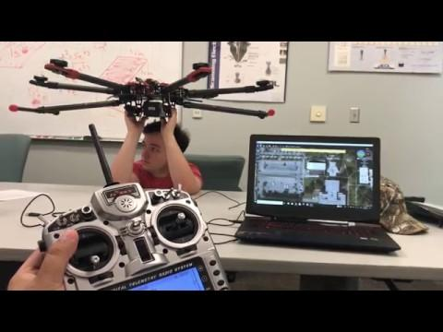
Video (Just in case we aren't allowed to do a demo in class)

